Slide 1

SPM PM Review
G4T4
PM: Tsang Bao Xian
Casper Lim Zhi Xin
Tricia Tan Li Lin
Ong Yan Ning
Loh Xiao Binn

Slide 2

Functionalities
Wiki Question | Answer
Do you plan to drop/add any functionalities? | No
Do you plan to use any PHP frameworks? | No
Did you manage to finish login + 1 functionality? | Yes
What functionalities have you finished? | Login, add bid, bootstrap
What is the IP address & admin password for your cloud deployment? | IP Address: 54.169.210.219 Admin password: @dm1in5PM

Slide 3

Schedule Overview
Weekly Meetings on Tuesdays and Fridays.
Task set on Friday has deadline on Tuesday → 4 Working Days
Task set on Tuesday has deadline on Friday → 3 Working Days

Slide 4
Planned Iterations
Iteration | Task | Start Date | End Date
1 | Login, Add bid, Bootstrap Functionality | Monday of Week 5 | Sunday of Week 6 (end)
2 | Drop bid, Slides for PM review, Web service, Update bid | Monday of Week 7 | Sunday of Week 8
3 | Rounds, Drop section, Dumping | Monday of Week 9 | Sunday of Week 10
4 | Deploying to AWS, UAT, Check UAT results, testing, debugging, redeploy | Monday of Week 11 | Sunday of Week 12
5 | Prepare Final presentation slides | Monday of Week 13 | Sunday of Week 14

Slide 5
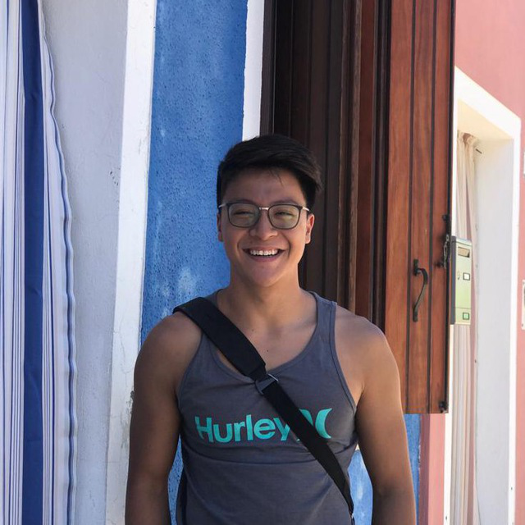
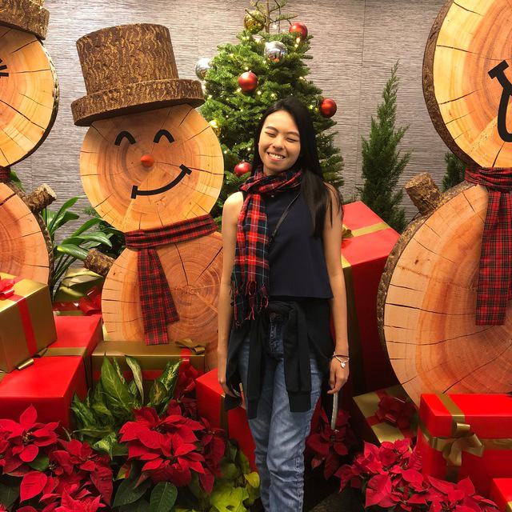
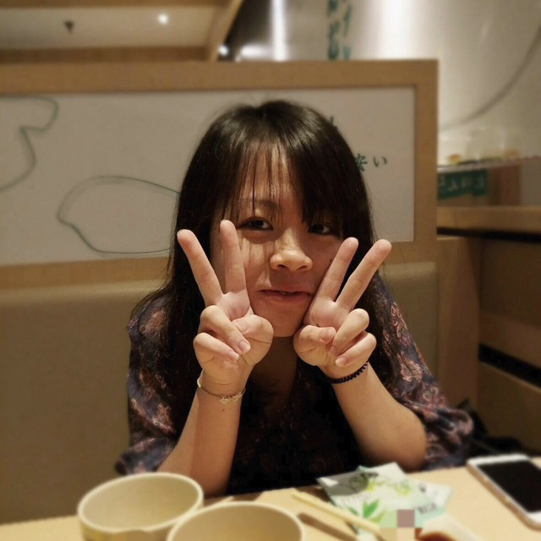


Roles & Task Allocation
d
Bao Xian
PM, Bootstrap validation & Login & Add Bid functionality
Loh Xiao Binn
Administrative, bootstrap functionality , test cases
Tricia Tan
Login framework & Add Bid functionality & bootstrap debugging
Yan Ning
Administrative, bootstrap framework , test cases
Casper Lim
Bootstrap validation & Login & Add Bid functionality

Slide 6
Milestones
27 September – End of Iteration
13 October – PM review
13 September – End of Iteration 2
17 October – Application Demo
27 October – End of Iteration 3
31 October – User Acceptance Test
10 November – End of Iteration 4
17 November – Final submission
21 November – Final Presentation

Slide 7
PM in-charge of Milestones
Milestone | PM
End of Iteration 1 | Bao Xian
PM Review | Tricia
End of Iteration 2 | Tricia
Application Demo | Celine
End of Iteration 3 | Celine
User Acceptance Test | Casper
End of Iteration 4 | Casper
Final Submission | Yan Ning
Final Presentation | Yan Ning

Slide 8
Buffer Time
Deadlines set at next meeting
Taking over/ Helping each other at meetings if any of us face any difficulties
Use Meeting time as buffer to debug

Slide 9
Critical Path (Iteration 1)
Start
Read Wiki
Schedule Iteration 1 tasks
Plan other Iterations
Create Login Page with Welcome Message
Create project database & Complete authentication
Test
Login Page
Test
Iteration 1
Test
Bootstrap
File validations
Add .csv values into database
Create Bootstrap interface
Create addBid page
End

Slide 10
Critical Path (Iteration 2)
Start
AWS Deployment
Validations (addBid, Bootstrap)
Drop Bid
JSON Web Service
Update Bid
Online Review
Preparation
(Milestone)
Iteration Deployment
Iteration Testing
Iteration
Integration
End

Slide 11
Critical Path (Iteration 3)
Start
Rounds
Drop Section
JSON Dumping
Iteration Integration
Iteration Testing
UAT
Preparation
(Milestone)
Iteration Deployment
End

Slide 12
Critical Path (Iteration 4)
Start
Integration
Web Application
Testing
Web Service Testing
AWS Deployment
Final Submission
Preparation
(Milestone)
End

Slide 13

Bug Metrics
Wiki Question | Answer
What is the current value for the metric? | 97
Did you have to take any action according to your mitigation plan? | Yes, debugging session was carried out during group meetings

Slide 14
Roles & Responsibilities
d
Bao Xian
PM, Bootstrap validation & Login & Add Bid functionality
Loh Xiao Binn
Administrative, bootstrap functionality , test cases
Tricia Tan
Login framework & Add Bid functionality & bootstrap debugging
Yan Ning
Administrative, bootstrap framework , test cases
Casper Lim
Bootstrap validation & Login & Add Bid functionality

Slide 15
Paired Programming Rotation Plan
Functionality | Paired Programmer | Paired Programmer
Login Functionality & Validations | Casper Lim | Tricia Tan
Add Bid | Tricia Tan | Bao Xian
Bootstrap Framework (1) | Bao Xian | Yan Ning
Bootstrap Framework (2) | Yan Ning | Xiao Binn
Bootstrap Validations & Debugging (1) | Xiao Binn | Casper Lim
Bootstrap Validations & Debugging (2) | Casper Lim | Yan Ning
Bootstrap Validations & Debugging (3) | Yan Ning | Bao Xian
Bootstrap Validations & Debugging (4) | Bao Xian | Tricia Tan

Slide 16
Thank You

